Slide 1

Inheritance
In a hierarchy, it is possible for both superclasses and subclasses to have their own constructors.
The preceding examples have relied upon the default constructors created automatically by Java.
However, in practice, most classes will have explicit constructors.
Here we will see how to handle this situation.

Slide 2
Inheritance
When only the subclass defines a constructor, the process is straightforward: simply construct the subclass object.
The superclass portion of the object is constructed automatically using its default constructor.

Slide 3
Inheritance
For example, here is a reworked version of Triangle that defines a constructor.
It also makes style private, since it is now set by the constructor.

Slide 4
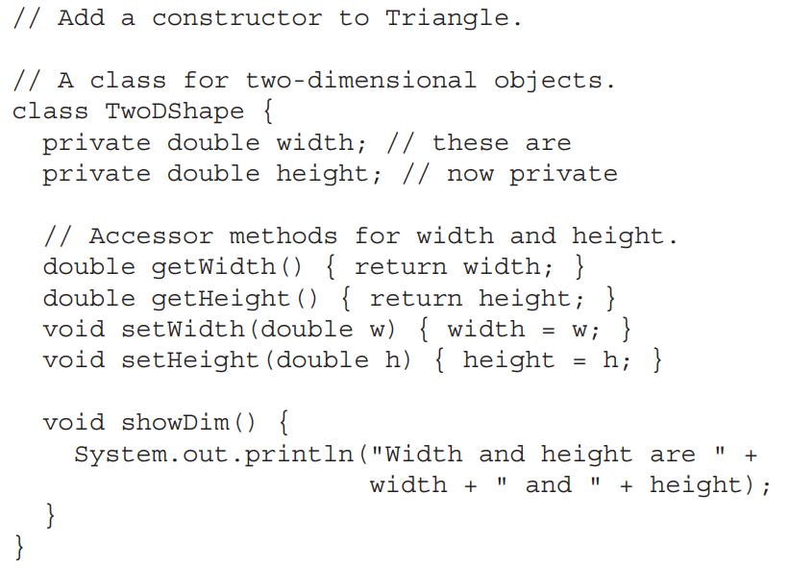
Inheritance

Slide 5
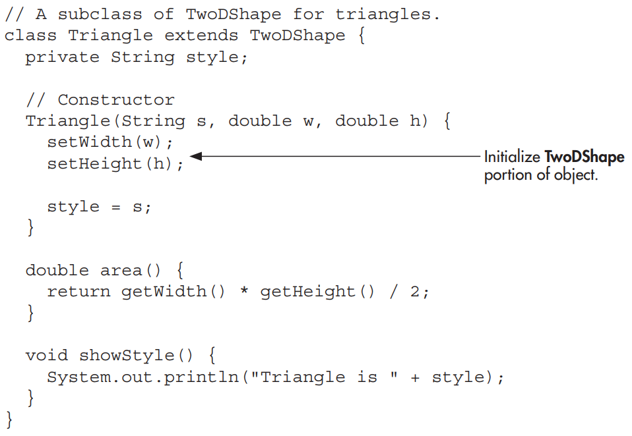
Inheritance

Slide 6
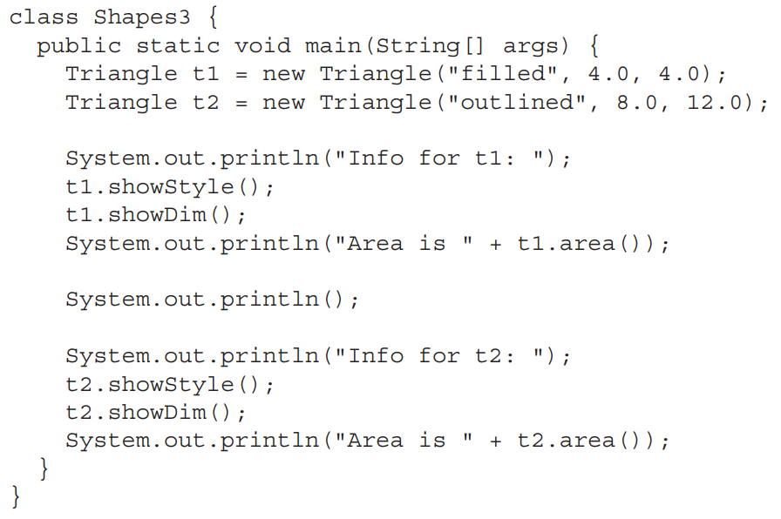
Inheritance

Slide 7
Inheritance
When both the superclass and the subclass define constructors, the process is a bit more complicated because both the superclass and subclass constructors must be executed.
In this case, you must use another of Java’s keywords, super, which has two general forms.
The first calls a superclass constructor.
The second is used to access a member of the superclass that has been hidden by a member of a subclass.

Slide 8

Inheritance
Here, we will look at its first use.
A subclass can call a constructor defined by its superclass by use of the following form of super:
Here, parameter-list specifies any parameters needed by the constructor in the superclass. super( ) must always be the first statement executed inside a subclass constructor.

Slide 9
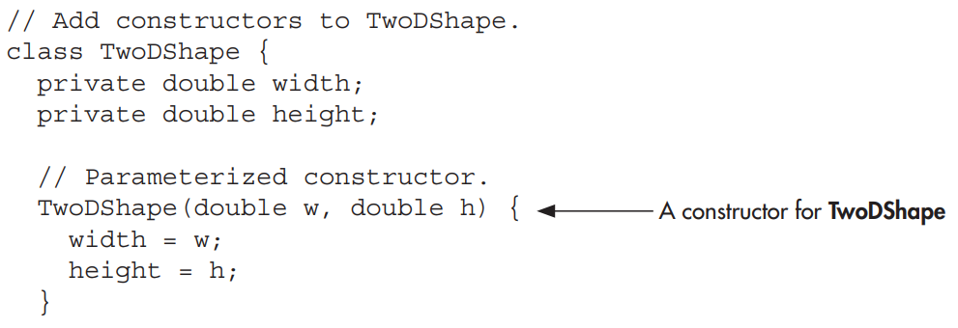
Inheritance
To see how super( ) is used, consider the version of TwoDShape in the following program. It defines a constructor that initializes width and height.

Slide 10
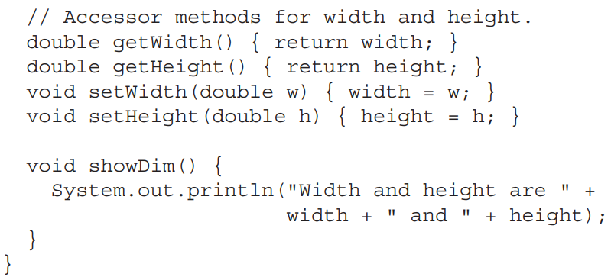
Inheritance

Slide 11
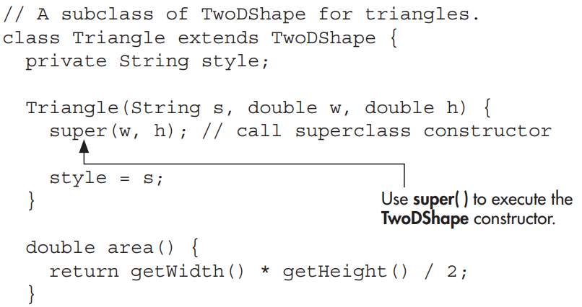
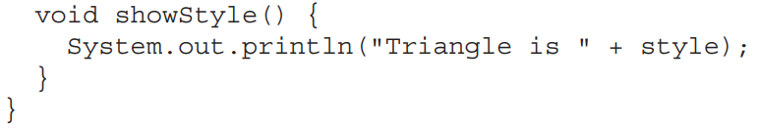
Inheritance

Slide 12

Inheritance

Slide 13
Inheritance
Any form of constructor defined by the superclass can be called by super( ).
The constructor executed will be the one that matches the arguments. For example, here are expanded versions of both TwoDShape and Triangle that include default constructors and constructors that take one argument:

Slide 14
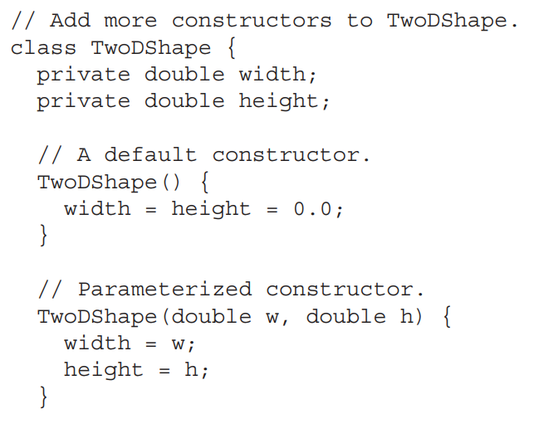
Inheritance

Slide 15
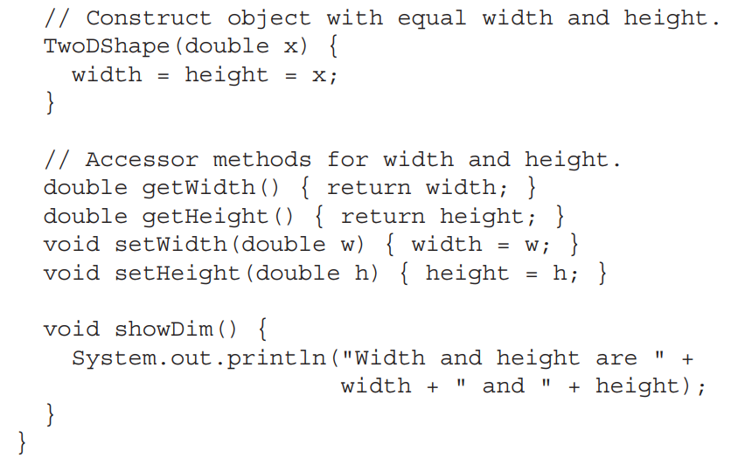
Inheritance

Slide 16
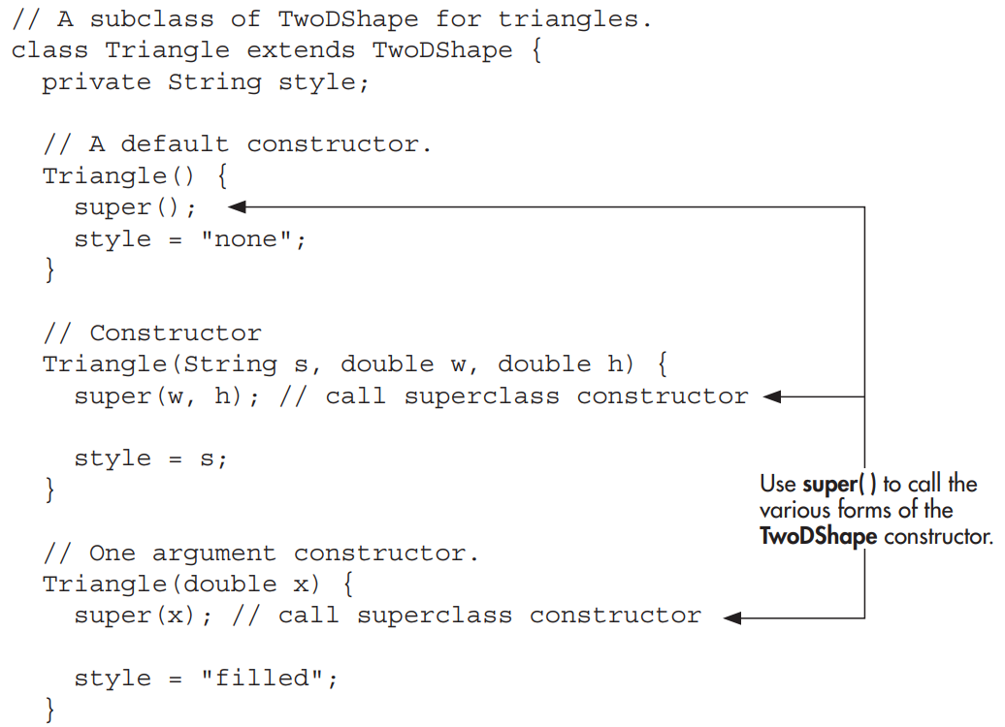
Inheritance

Slide 17
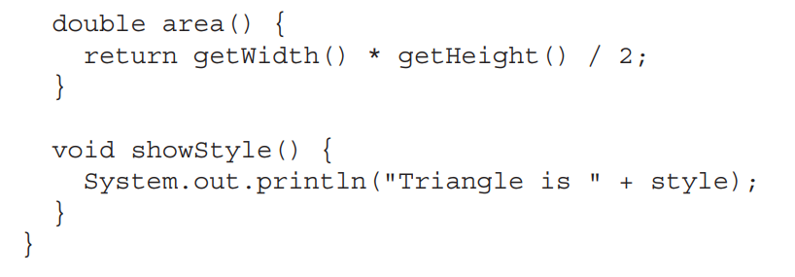
Inheritance

Slide 18
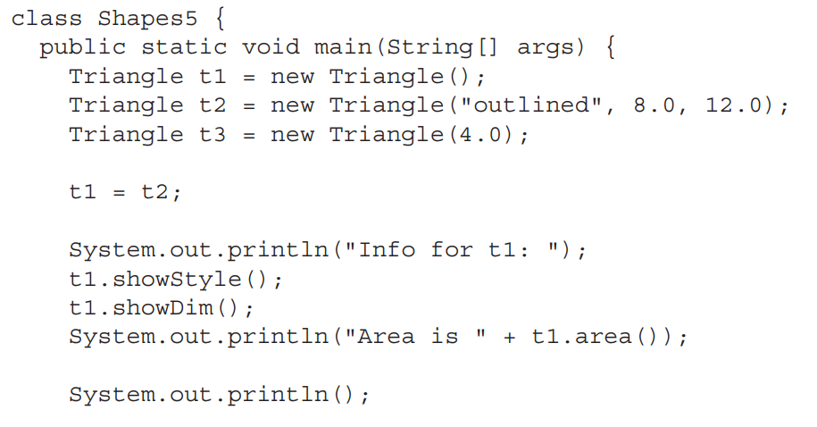
Inheritance

Slide 19
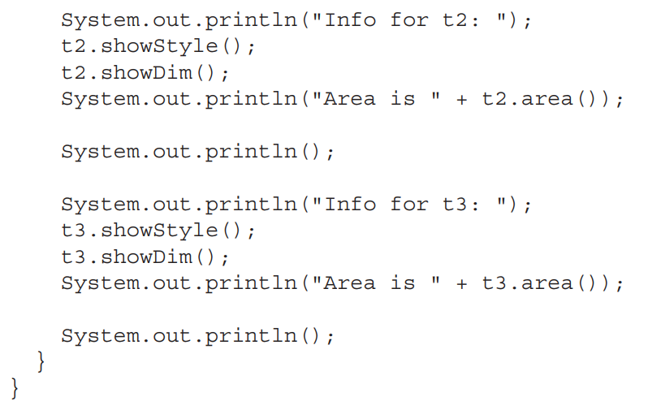
Inheritance

Slide 20
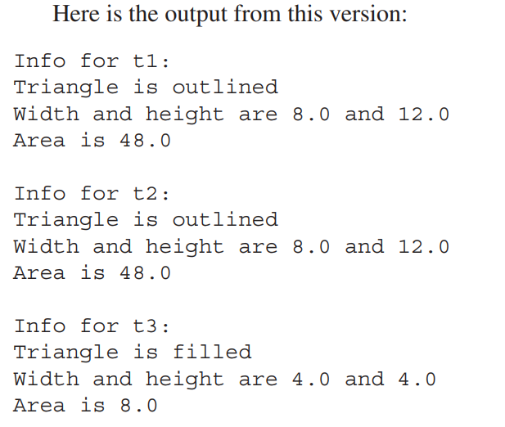
Inheritance

Slide 21
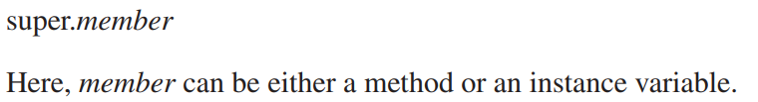
Inheritance
There is a second form of super that acts somewhat like this, except that it always refers to the superclass of the subclass in which it is used. This usage has the following general form:

Slide 22
Inheritance
This form of super is most applicable to situations in which member names of a subclass hide members by the same name in the superclass. Consider this simple class hierarchy:

Slide 23
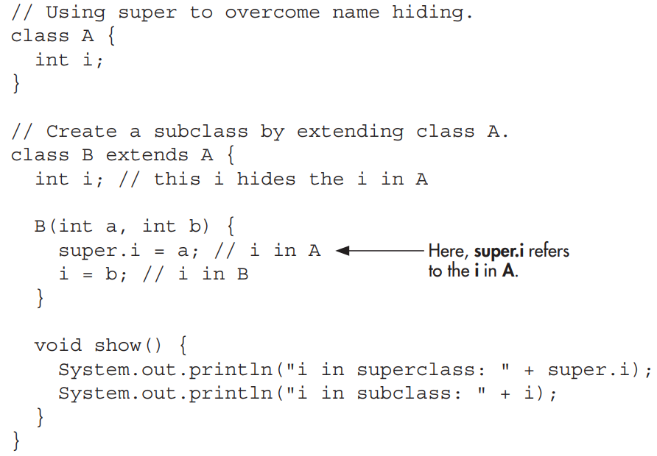
Inheritance

Slide 24
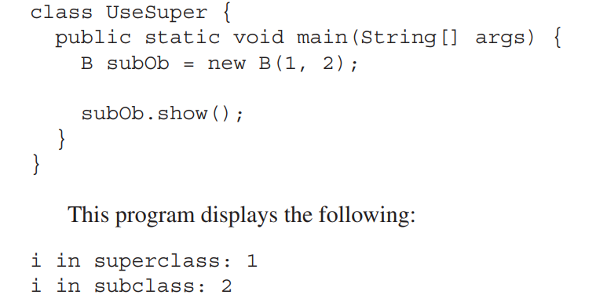
Inheritance

Slide 25

Inheritance
Up to this point, we have been using simple class hierarchies that consist of only a superclass and a subclass.
However, we can build hierarchies that contain as many layers of inheritance as we like.
As mentioned, it is perfectly acceptable to use a subclass as a superclass of another.

Slide 26
Inheritance
To see how a multilevel hierarchy can be useful, consider the following program.
In it, the subclass Triangle is used as a superclass to create the subclass called ColorTriangle. ColorTriangle inherits all of the traits of Triangle and TwoDShape and adds a field called color, which holds the color of the triangle.

Slide 27
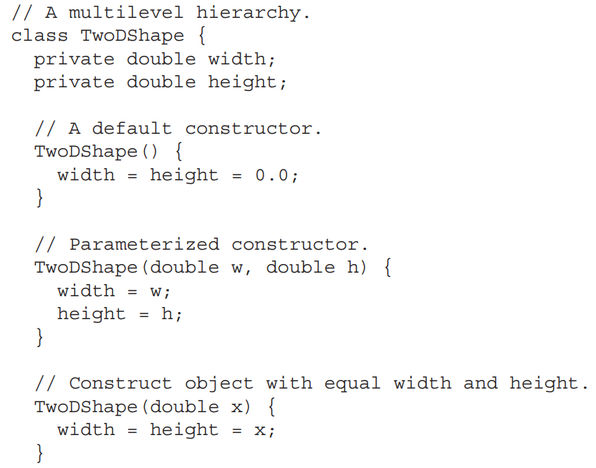
Inheritance

Slide 28

Inheritance

Slide 29
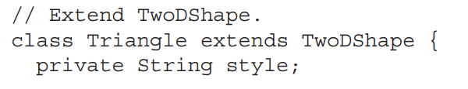
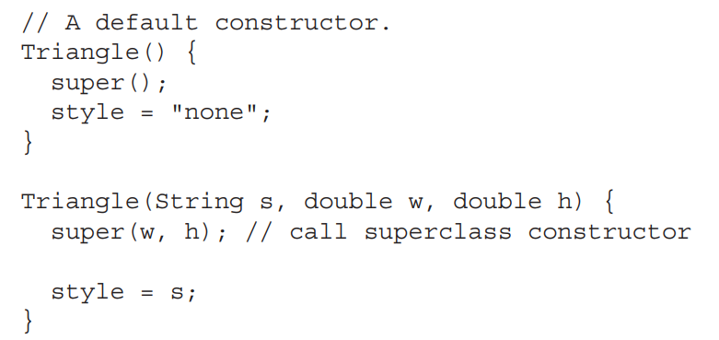
Inheritance

Slide 30
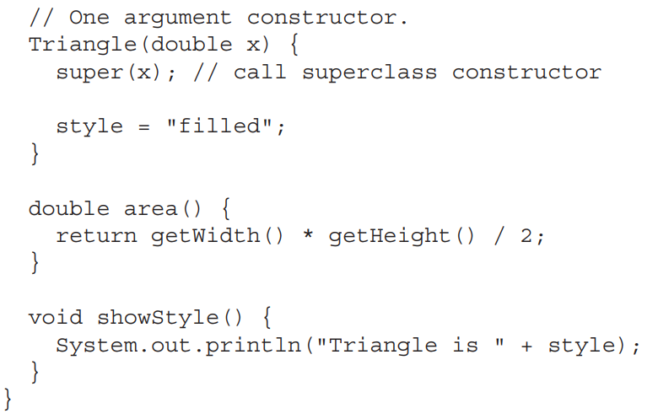
Inheritance

Slide 31
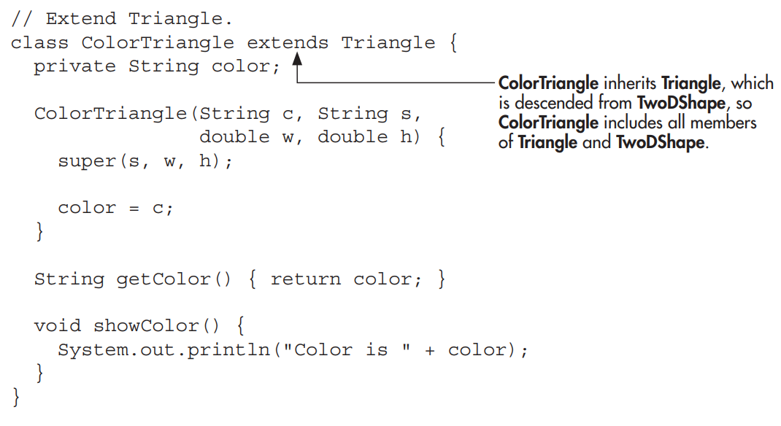
Inheritance

Slide 32
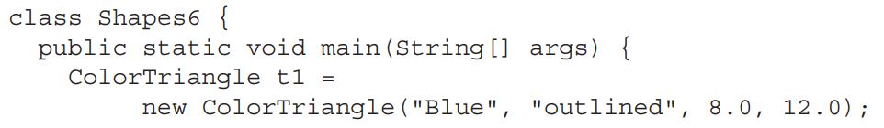
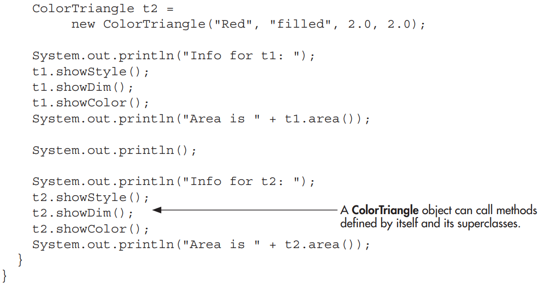
Inheritance

Slide 33
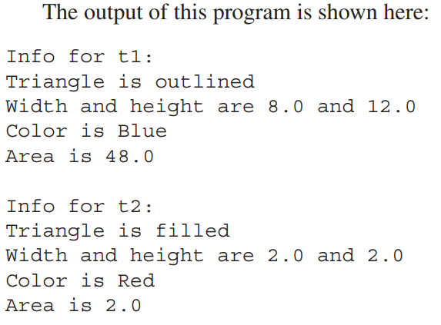
Inheritance

Slide 34
Inheritance
In a class hierarchy, constructors complete their execution in order of derivation, from superclass to subclass.
Further, since super( ) must be the first statement executed in a subclass’ constructor, this order is the same whether or not super( ) is used.
If super( ) is not used, then the default (parameterless) constructor of each superclass will be executed.

Slide 35
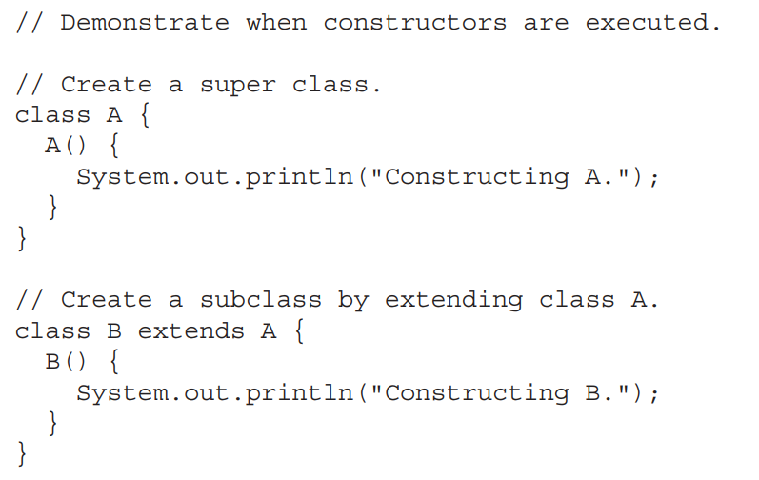
Inheritance

Slide 36
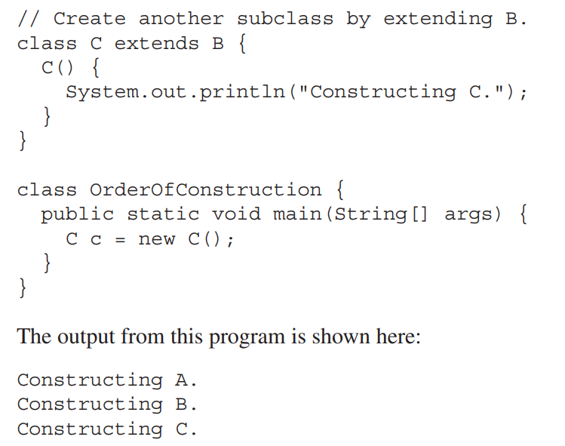
Inheritance

Slide 37
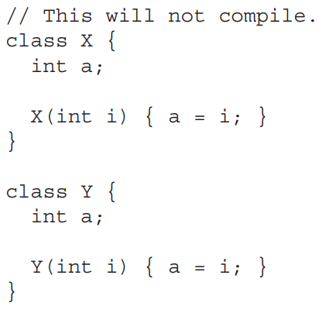
Inheritance
A reference variable for one class type cannot normally refer to an object of another class type. For example, consider the following program:

Slide 38
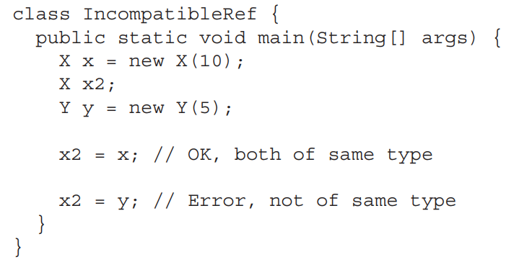
Inheritance

Slide 39
Inheritance
There is, however, an important exception to Java’s strict type enforcement.
A reference variable of a superclass can be assigned a reference to an object of any subclass derived from that superclass.
In other words, a superclass reference can refer to a subclass object. Here is an example:

Slide 40
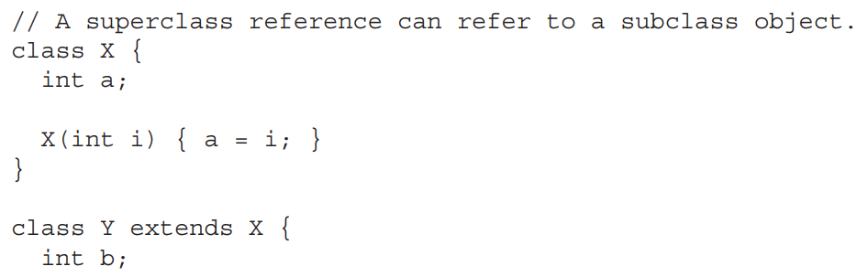
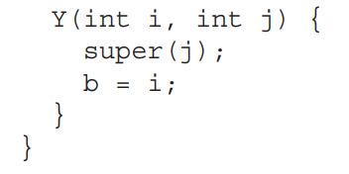
Inheritance

Slide 41
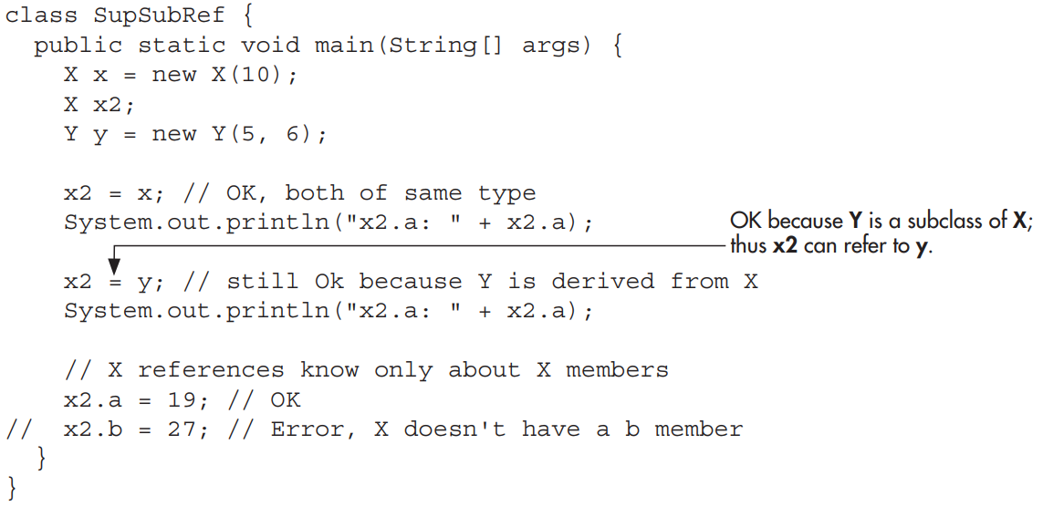
Inheritance

Slide 42
Inheritance
It is important to understand that it is the type of the reference variable—not the type of the object that it refers to—that determines what members can be accessed.
That is, when a reference to a subclass object is assigned to a superclass reference variable, you will have access only to those parts of the object defined by the superclass.
This is why x2 can’t access b even when it refers to a Y object.

Slide 43
Inheritance
If you think about it, this makes sense, because the superclass has no knowledge of what a subclass adds to it. This is why the last line of code in the program is commented out.

Slide 44
Inheritance
An important place where subclass references are assigned to superclass variables is when constructors are called in a class hierarchy.
As you know, it is common for a class to define a constructor that takes an object of the class as a parameter. This allows the class to construct a copy of an object.

Slide 45
Inheritance
Subclasses of such a class can take advantage of this feature.
For example, consider the following versions of TwoDShape and Triangle. Both add constructors that take an object as a parameter.

Slide 46
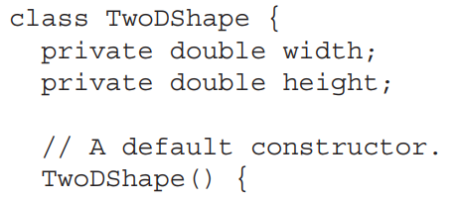
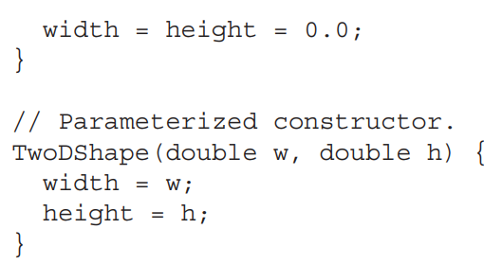
Inheritance

Slide 47
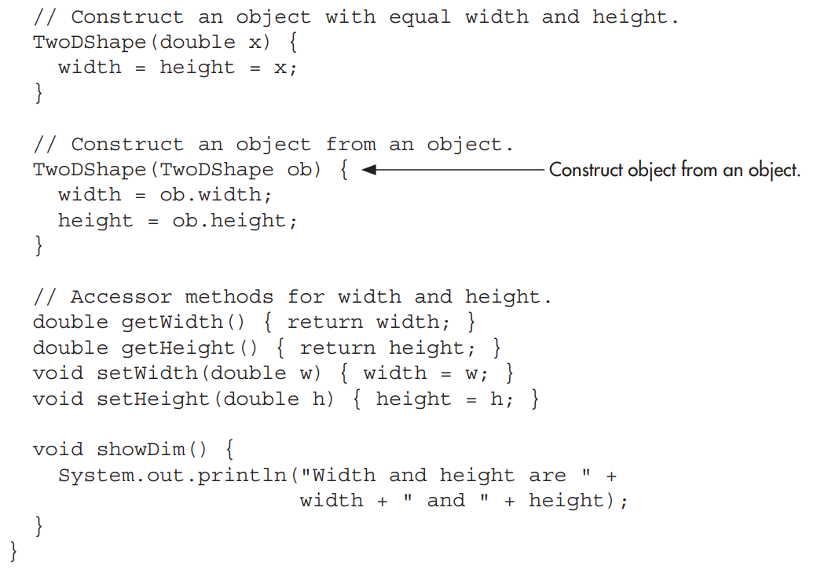
Inheritance

Slide 48
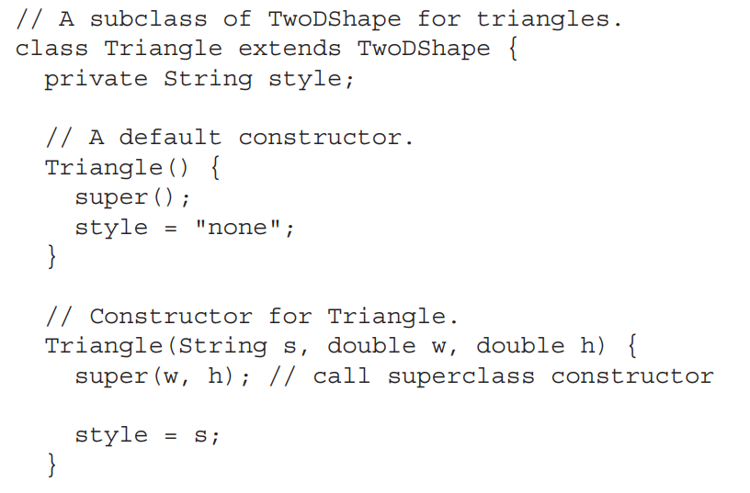
Inheritance

Slide 49
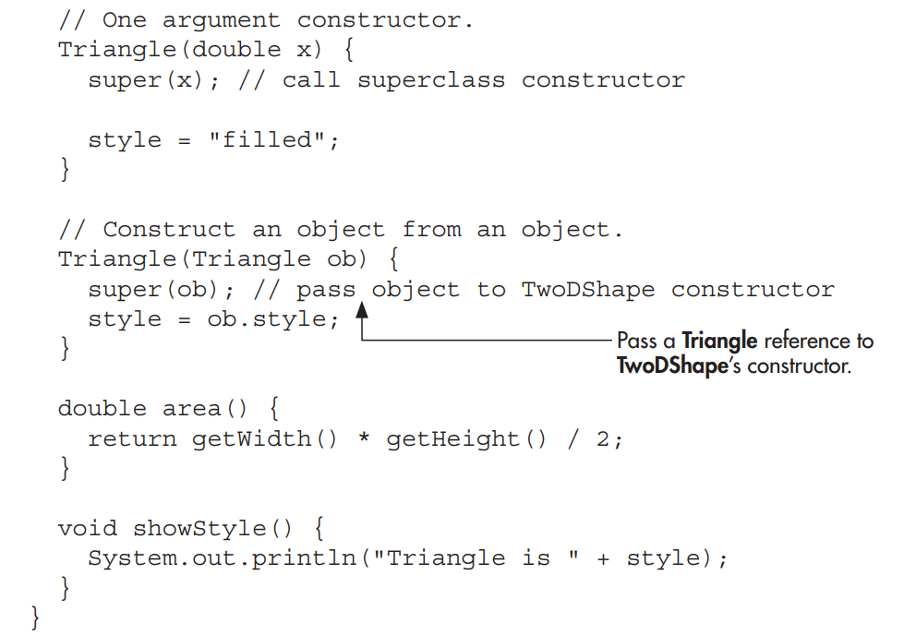
Inheritance

Slide 50
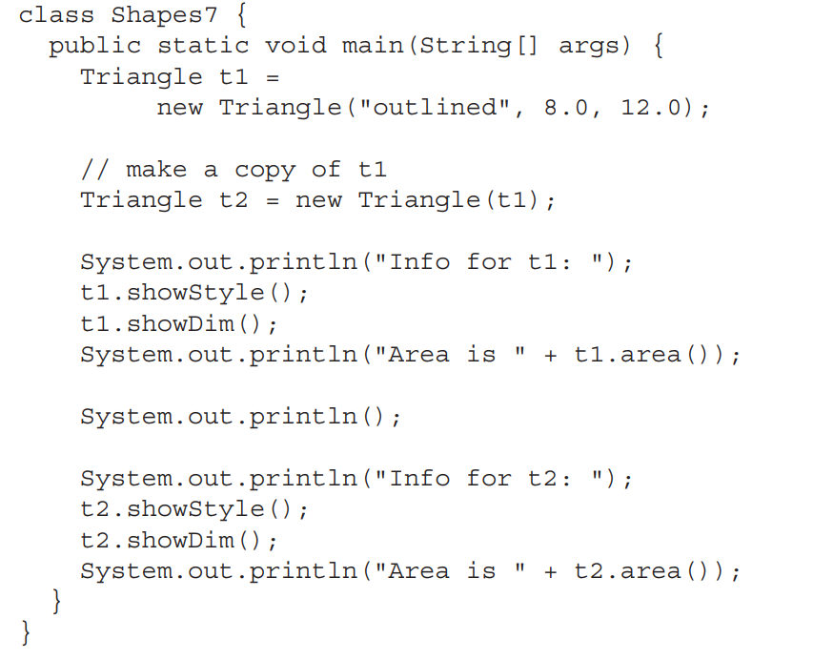
Inheritance

